Slide 1
Rhanbarth Gogledd Cymru
www.llaiswales.org

Slide 2
Cyflwyno heddiw
Geoff Ryall-Harvey
Cyfarwyddwr Rhanbarthol – Gogledd Cymru
www.llaiswales.org
Notes:
Introduce yourself, your background and how and why you got involved with Llias.
Explain what will be covered today:
What, who and how….

Slide 3
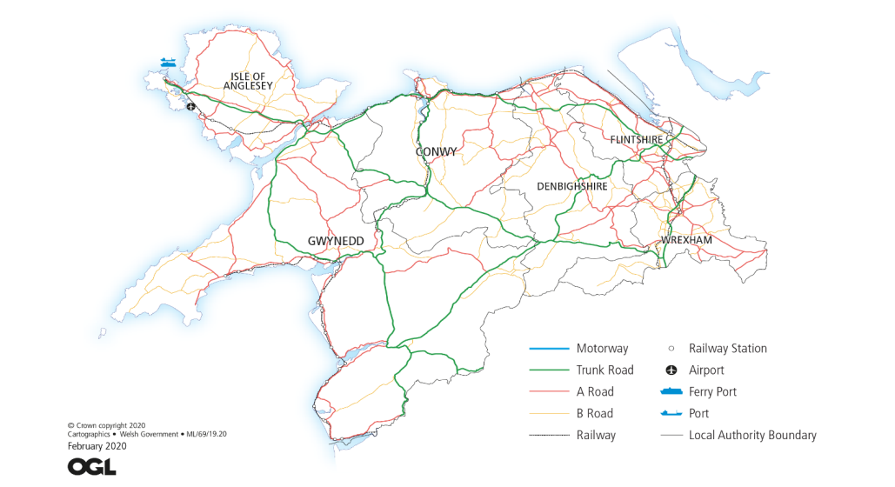
Mae gan Ranbarth Gogledd Cymru swyddfeydd ym Mangor a Wrecsam. Mae pellteroedd yn hir yng Ngogledd Cymru; taith gron 150 milltir rhwng y ddwy swyddfa. Mae hi’n 115 milltir o Gaergybi yn y Gogledd i Ellesmere ger ffin Swydd Amwythig.
Notes:
Staff – CHC staff transferring over plus more staff to help support an expanded remit across health and social care.
Volunteers – people living in and representing local communities

Slide 4
Mae 6 awdurdod lleol yn darparu gofal cymdeithasol yng Ngogledd Cymru;
Ynys Môn
Conwy
Gwynedd
Sir y Fflint
Sir Ddinbych
Wrecsam
Mae’r poblogaeth yn amrywio o 155,000 yn Sir y Fflint i 70,000 yn Ynys Môn – cyfanswm y boblogaeth yw tua 730,000.
Notes:
Reference to the legal name.. ‘you may know us by another name’… Citizen Voice Body for Health and Social Services Wales. Explain our operational name will be Llais, ties to our Welsh identity and reflects our more modern, relatable and less formal approach.

Slide 5
Bwrdd Iechyd Prifysgol Betsi Cadwaladr yw’r sefydliad iechyd mwyaf yng Nghymru, gyda chyllideb o £1.87 biliwn a gweithlu o dros 19,000. Mae’r Bwrdd Iechyd yn gyfrifol am ddarparu gwasanaethau gofal iechyd i bron i 3/4 M o bobl ar draws chwe sir Gogledd Cymru.
Mae yna 3 Ysbyty Cyffredinol Dosbarth a 15 Ysbyty Cymunedol. Mae’r Bwrdd Iechyd yn cydlynu gwaith 96 o feddygfeydd teulu, a gwasanaethau’r GIG a ddarperir gan 83 o bractisau deintyddol ac orthodontig, 69 o bractisau optometreg ac optegwyr a 147 o fferyllfeydd yng Ngogledd Cymru.
Notes:
Reference to the legal name.. ‘you may know us by another name’… Citizen Voice Body for Health and Social Services Wales. Explain our operational name will be Llais, ties to our Welsh identity and reflects our more modern, relatable and less formal approach.

Slide 6
Mesurau Arbennig
Treuliodd BIPBC 5 mlynedd mewn Mesurau Arbennig ac fe’u dychwelwyd ym mis Mawrth 2023 gan Lywodraeth Cymru mewn perthynas â’r meysydd pryder a nodwyd mewn adroddiad gan Archwilio Cymru….
Notes:
Governance and board effectiveness.
Workforce and organisational development
Finance and audit
Compassionate leadership and culture
Clinical governance, patient experience and safety
Operational delivery
Planning and service transformation
The Chair, Vice-Chair and other Independent Board Members were removed by the Minister in March and the Executive Team was criticised. The Executive Team remain in place and the Chair and Independent Board members have been replaced with interim appointments.
Public confidence in BCUHB is very low and has been for over ten years.

Slide 7
Mae gwasanaethau iechyd meddwl yng Ngogledd Cymru yn parhau i danberfformio’n sylweddol ac, unwaith eto, yn rhan o’r fframwaith Mesurau Arbennig…….
Gwasanaethau Iechyd Meddwl
Notes:
Many of the issues identified in the Ockenden, HASCAS and the Holden reports, some over ten years ago, are still outstanding. We await an action plan from BCUHB.
We believe that under-staffing is a key issue. There are currently over 200 mental health nursing vacancies and 50 psychiatrist vacancies.
We await several inquests into deaths in the Mental Health Service and there is also a HSE prosecution related to a suicide death.
In the past two years we have received reports of abuse of older patients, mainly with dementia and other mental health conditions, in Morfa Ward in Llandudno Hospital and, much more seriously, in Morris Ward at Wrecsam Maelor.
NWCHC unannounced visits since the pandemic concentrated on the patient experience. Members were concerned at the very extensive use of agency nurses and the consequent lack of consistency and awareness of individual patient need as well as local procedures and protocols. The MHLD Directorate is currently carrying over 200 nursing vacancies and 50 psychiatrist vacancies.

Slide 8
Gwasanaethau Gofal Sylfaenol
Yng Ngogledd Cymru fel mewn mannau eraill, mae cleifion yn adrodd anhawster wrth gael mynediad at feddygon teulu.
Mae mynediad i ddeintydd GIG bron yn amhosibl mewn rhannau helaeth o'r ardal.
Notes:
Some patients using e-consult report that they are told to expect a phone call in two to three weeks rather than getting an appointment. Attendees at our various Safe Space events consistently report that they cannot get appointments to discuss their symptoms and are directed to websites giving general information.
Patients are being advised to travel long distances to see an NHS dentist. Patients tell us of being quoted waits of up to two years to receive NHS dental treatment.

Slide 9
Amseroedd Aros
Ym mis Ebrill cwblhawyd ein digwyddiadau Man Diogel ar effaith amseroedd aros hir ar fywydau cleifion.
Clywsom rai straeon trallodus am y boen a’r dioddefaint a achosir gan arosiadau hir, iselder, anawsterau arian a chyflogaeth a thoriadau perthynas……….
Notes:
This is very much what we heard in 2018 when we undertook similar listening events.
What is different post-pandemic is that people we spoke to expressed a wish to be treated anywhere at all, as long as it is soon. Many people also see private treatment (funded by family donations or a loan/second mortgage) as the more realistic alternative to NHS treatment.

Slide 10
Amseroedd Aros
Claf A - Dechreuodd fy mhroblemau ym mis Tachwedd 2020 pan gefais boen ofnadwy yn fy nghlun - fe'i torrais pan oeddwn yn fy 40au ac nid wyf wedi cael unrhyw broblemau ag ef tan hynny. Cefais fy anfon i ysbyty Bae Colwyn am belydr-x, roedd y glun wedi dirywio y tu hwnt, a chefais fy atgyfeirio at YGC. Derbyniais lythyr ym mis Mehefin 2021, ond yna digwyddodd Covid ac ni dderbyniais unrhyw ohebiaeth bellach.
Gwaethygodd y boen, ac mae wedi effeithio ar fy mherthynas gyda fy mhartner. Mae hyn nawr hefyd yn effeithio ar fy nghlun da. Dywedwyd wrthyf na fyddaf yn cael fy ngweld am flwyddyn arall ac ni allaf fforddio mynd yn breifat.
Roedd yn rhaid i mi adael fy swydd, ac roeddwn wrth fy modd yno, ni allwn ei wneud oherwydd y boen. Roeddwn i mor anobeithiol nes i hyd yn oed edrych ar fynd i Lithuania i wneud fy nghluniau. Ni allaf hyd yn oed gerdded i’r parc i wylio fy ŵyr yn chwarae rygbi mwyach. Mae fy mywyd wedi gorffen, rwy'n teimlo weithiau fel neidio oddi ar y Gogarth. Does gen i ddim bywyd cymdeithasol bellach, prin y gallaf fynd allan na gyrru'n bell iawn. Mae gennyf berthnasau yn Lloegr, ond ni allaf yrru yno mwyach i’w gweld. Dydw i ddim wedi bod ar wyliau ers dros 3 blynedd, mae'n ofnadwy. Mae fy mywyd yn ofnadwy a dydw i ddim yn gwybod pa mor hir y gallaf fynd ymlaen fel hyn. Pam fod mwy o help ar gael yn Lloegr o gymharu â Chymru? Mae ein bywydau ni yr un mor bwysig â'u bywydau nhw. Rydyn ni fel dinasyddion eilradd. Yr unig opsiwn yw symud tŷ i Loegr, ond pam ddylem ni adael ein cartref, ffrindiau a theulu.
Notes:
Staff – CHC staff transferring over plus more staff to help support an expanded remit across health and social care.
Volunteers – people living in and representing local communities

Slide 11
Amseroedd Aros
Claf B - Mae gen i dwnnel carpel yn y ddwy arddwrn ac rwy'n aros am lawdriniaeth. Cefais sesiynau Ffisiotherapi dros y ffôn. Ychydig wythnosau yn ôl gwelais Ymgynghorydd Orthopedig a gynhaliodd rai profion a chadarnhaodd fod angen llawdriniaeth. Mae 2 flynedd wedi mynd heibio ers imi ddechrau gweld rhywun, a does dal ddim dyddiad ar gyfer y llawdriniaeth. Byddwn yn hapus i deithio i unrhyw le ar gyfer y llawdriniaeth.
Claf C - Rwy'n dioddef o arthritis yn y ddwy glun - mae hyn yn cael effaith sylweddol ar bob agwedd ar fy mywyd. Alla i wir ddim mynd ymlaen fel hyn – beth yw’r pwynt? Mynychais Ysbyty Alltwen i weld y podiatrydd er mwyn i mi gael mewnwadnau ar gyfer fy esgidiau. Roedd hi wedi rhyfeddu i weld faint o boen roeddwn i’n ei ddioddef ac rwy’n ei chofio’n dweud ‘sut allan nhw eich gadael chi mewn cymaint o boen!’
Es i weld Mr XXXXXX yn breifat – roedd yn ystyried bod y difrod i’m clun mor ddrwg fel y byddai angen ei newid o fewn 2 fis – fel arall byddai’n ‘popio allan’. Byddai'n costio £28,000 i wneud hyn yn breifat. Ni allaf fforddio hynny.
Notes:
Staff – CHC staff transferring over plus more staff to help support an expanded remit across health and social care.
Volunteers – people living in and representing local communities

Slide 12
Tawel Fan
Ward iechyd meddwl oedd yn gofalu am bobl oedd yn byw gyda dementia oedd Tawel Fan. Cafodd honiadau o gamdriniaeth eu cydnabod gan y bwrdd ym mis Rhagfyr 2013.
Bron i 10 mlynedd yn ddiweddarach……..
Notes:
Tawel Fan was a mental health ward looking after dementia patients. Allegations of ill-treatment were acknowledged by the board in December 2013. An independent report into the charges, by NHS executive and midwifery expert Donna Ockenden, the Ockenden Report was made public, with the summary branding of what took place on the ward as “institutional abuse”.
It catalogued distressing tales of dementia patients left to roam unsupervised, others being locked in rooms, some lying in their own faeces and urine, and records being altered. It later transpired there were 108 individual Tawel Fan patient cases warranting investigation. A second report, costing more than £2m and conducted by now defunct private consultancy firm HASCAS, later looked into the individual cases – controversially finding no institutional abuse had taken place.
In 2022 the ICO instructed BCUHB to release the Holden Report – this report undertaken in 2013 outlined the key messages contained in Ockenden and, potentially, prevented the problems at Tawel Fan. There were a number of other reports over this period that highlighted problems but their recommendations were never implemented. BCUHB have undertaken to produce an action plan that aggregates all of the recommendations of the many reports. We await sight of this plan.

Slide 13
Gwasanaethau Fasgwlaidd
Cafodd gwasanaethau fasgwlaidd cymhleth eu canoli o Ysbyty Gwynedd ym Mangor ac Ysbyty Maelor Wrecsam i Ysbyty Glan Clwyd ym mis Ebrill 2019.
2020 - Adroddiad CIC yn codi pryderon
Xxxx - Amlygodd adolygiad annibynnol Coleg Brenhinol y Llawfeddygon 9 argymhelliad brys i fynd i’r afael â risgiau diogelwch cleifion
2022 – Mae pryderon yn parhau yn dilyn 2 ‘ddigwyddiad byth’
2023 – Mae adroddiadau Arolygiaeth Gofal Iechyd Cymru yn dangos gwelliant ond mae gwaith i'w wneud o hyd
2023 – Cefnogi pobl a nodwyd drwy adolygiad CBLl
Notes:
Against the advice of North Wales CHC, the health board declined to undertake an engagement, preferring to rely on a consulation from 8 years earlier.
Following the centralisation NW CHC began to receive many complaints and concerns about the quality of vascular care and the difficulty in accessing treatment. NW CHC to the decision to undertake a series of Safe Space events across North Wales. These events were attended by hundreds of local people and NHS staff.
Our report detailed dozens of concerning incidents and it was clear that patients had no confidence in the health board to deliver safe or timely vascular care. In the rush to open the new specialist centre, care quality had been severely compromised.
As a direct result of the CHC report, BCUHB commissioned the Royal College of Surgeons to conduct an independent review.
vascular bed capacity and associated nursing resources
on-call arrangements for MD review at spoke sites and timeliness of reviews
return of spoke services wherever possible
current lack of an effective diabetic foot pathway and need to establish a foot MDT at each site
clarification of admission arrangements at spoke sites - with diabetic foot sepsis to be treated locally whenever possible
lack of clarity on pathways
need to strengthen clinical governance arrangements at all sites
establishing strong clinical leadership and effective team working across the vascular service
Following two “Never Events” in late 2022, the Minister for Health and Social Services provided the health board with a ‘clear warning’ that if recommendations from the RCS reviews were not ‘sufficiently addressed’ within three months.
This month HIW issued a report on vascular services showing improvement but the full 9 recommendations have not yet been completed.
Overall, patients have paid the price for the slow progress towards service recovery since the failings were acknowledged following the CHCs Safe Space Report in Spring 2020.
Very recently BCUHB has issued letters to those patients (around 47 currently) covered by the RCS review. They admit to causing “harm” and offer to initiate the NHS Wales Redress procedures.
Through BCUHB, Llais has offered to provide advice and support. We have been asked to facilitate workshops, group meetings and support with the concerns process. This is something we did for the Tawel Fan Families.
Later this year, the Coroner will open an Article 2 inquest on the vascular deaths

Slide 14
Staffio a recriwtio
Mae recriwtio a chadw clinigwyr yn parhau i fod yn faes risg allweddol.
Notes:
BCUHB have recently temporarily closed Tywyn Community Hospital in order to better staff Dolgellau Hospital – both were seriously and dangerously under-staffed and the decision was taken to move all available staff to Dolgellau to keep one of the hospitals open.
This may only be a temporary solution as a number of the nurses have delayed retirement.

Slide 15
Blaenoriaethau
Cyn ei ddiddymu, ddaru i CICGC ymgysylltu â rhanddeiliaid i ofyn am adborth a sylwadau gyda golwg ar ddatblygu ei gynlluniau ar gyfer 2022-23. Y prif flaenoriaethau a nodwyd oedd;
Amseroedd Atgyfeirio i Driniaeth (RTT)
Fframwaith Ymyrraeth wedi'i Dargedu BIPBC – nawr mewn Mesurau Arbennig eto
Gwasanaethau Iechyd Meddwl
Gwasanaethau Fasgwlaidd gan gynnwys Llwybr Troed Diabetig
Gofal Sylfaenol (gan ganolbwyntio’n benodol ar fynediad at wasanaethau meddygon teulu a deintyddol)
Gofal a Gwasanaethau a ddarperir mewn Adrannau Achosion Brys
Gwasanaethau Offthalmoleg
Ysbytai Cymunedol ac Unedau Mân Anafiadau
Oedi wrth Drosglwyddo Gofal
Canolfannau Triniaeth Rhanbarthol – bellach wedi’u canslo gan Lywodraeth Cymru
Strategaeth Ddigidol BIPBC
Cydraddoldeb, Amrywiaeth a Hawliau Dynol
Iaith Gymraeg

Slide 16
Newidiadau i Wasanaethau Gogledd Cymru ers Ionawr 2023
Offthalmoleg gofal sylfaenol
Sgrinio llygaid diabetig
Gwasanaethau ffrwythlondeb Cymru
Meddygfa Bae Penrhyn
Symud radiotherapi pediatrig
Uned Mân Anafiadau Alltwen
Gwasanaethau oncoleg
Notes:
Primary care ophthalmology - National Terms of Service
Diabetic eye screening - To implement the UK NSC and Welsh Government policy change by implementing a low-risk recall pathway in the diabetic eye screening service so that those participants defined as low risk will be offered screening every two years compared to an annual offer.
Wales Fertility Servics - Wales Fertility Services and Swansea Bay Health Board
Penrhyn Bay GP practice - Changes to designated boundary. Some patients offered alternative GP practices
Paediatric radiotherapy move - A change to the pathway for conventional radiotherapy for paediatric patients under the care of Alder Hey Children’s Hospital. The transition to the new pathway is currently expected to go live on 3rd April 2023
MIU Alltwen - Closure of MIU services at Alltwen overnight at 20:00hrs on Friday the 19th of May and then service hours to change from 08:00hrs to 12 midnight on Saturday the 20th and Sunday the 21st of May.
Oncology services - Patients with diagnosed colorectal cancer (anal and rectum) requiring radiotherapy to receive treatment in Clatterbridge PPJV (Private Patient Joint Venture).

Slide 17
Ein gwasanaeth eiriolaeth cwynion
Rydym yn delio â thua 500 o gwynion ffurfiol y GIG bob blwyddyn. Rydym wedi derbyn ychydig iawn o gwynion gofal cymdeithasol hyd yn hyn. Nid yw ein gwasanaeth eiriolaeth yn ymchwilio i gwynion. Mae'n rhoi cymorth i achwynwyr wneud eu cwynion yn effeithiol.
Bu cynnydd sylweddol mewn “galwadau i weithredu” lle nad yw cleientiaid eisiau cwyno ond eisiau i rywbeth ddigwydd ar frys. Mae'r materion a godwyd yn cynnwys;
Anhawster i gael meddyginiaeth
Llawdriniaethau wedi'u canslo ac amseroedd aros hir
Anhawster cael mynediad at gymorth iechyd meddwl cymunedol
Problemau cysylltu â meddyg teulu
Anhawster cael triniaeth ddeintyddol
Pryder am oedi i driniaeth canser
Rydym yn aml yn gallu cynorthwyo drwy weithio drwy ein rhwydweithiau anffurfiol. Gobeithiwn ymestyn hyn i ofal cymdeithasol wrth i berthnasoedd ddatblygu

Slide 18
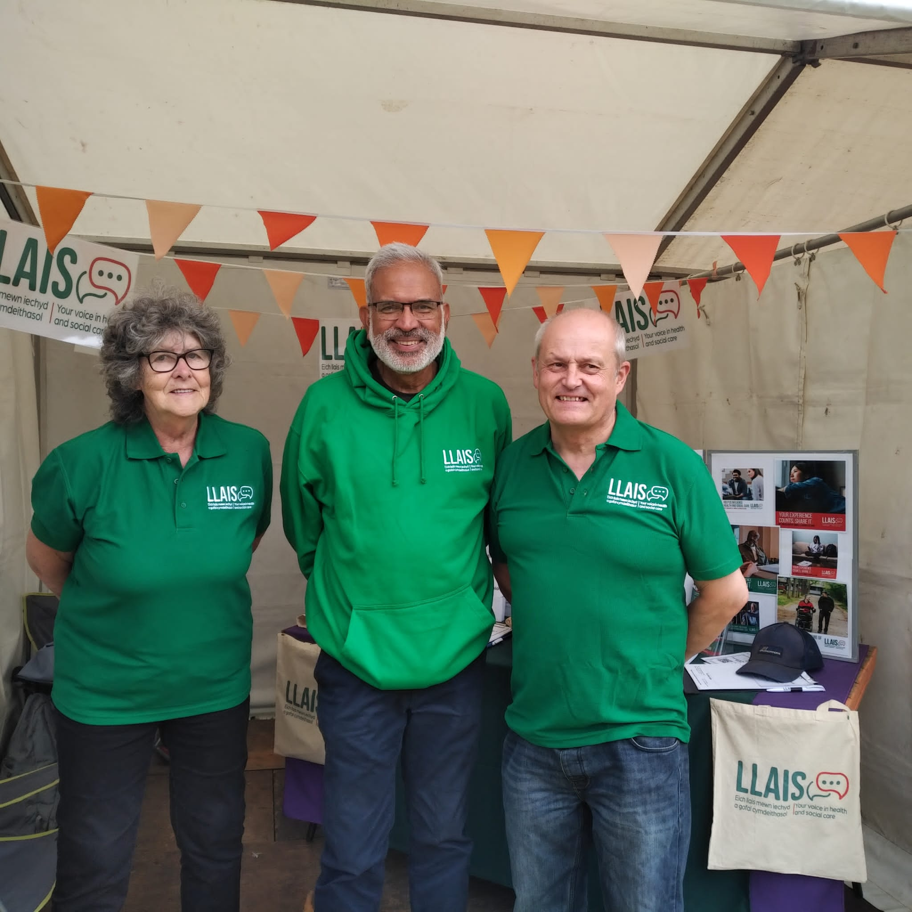
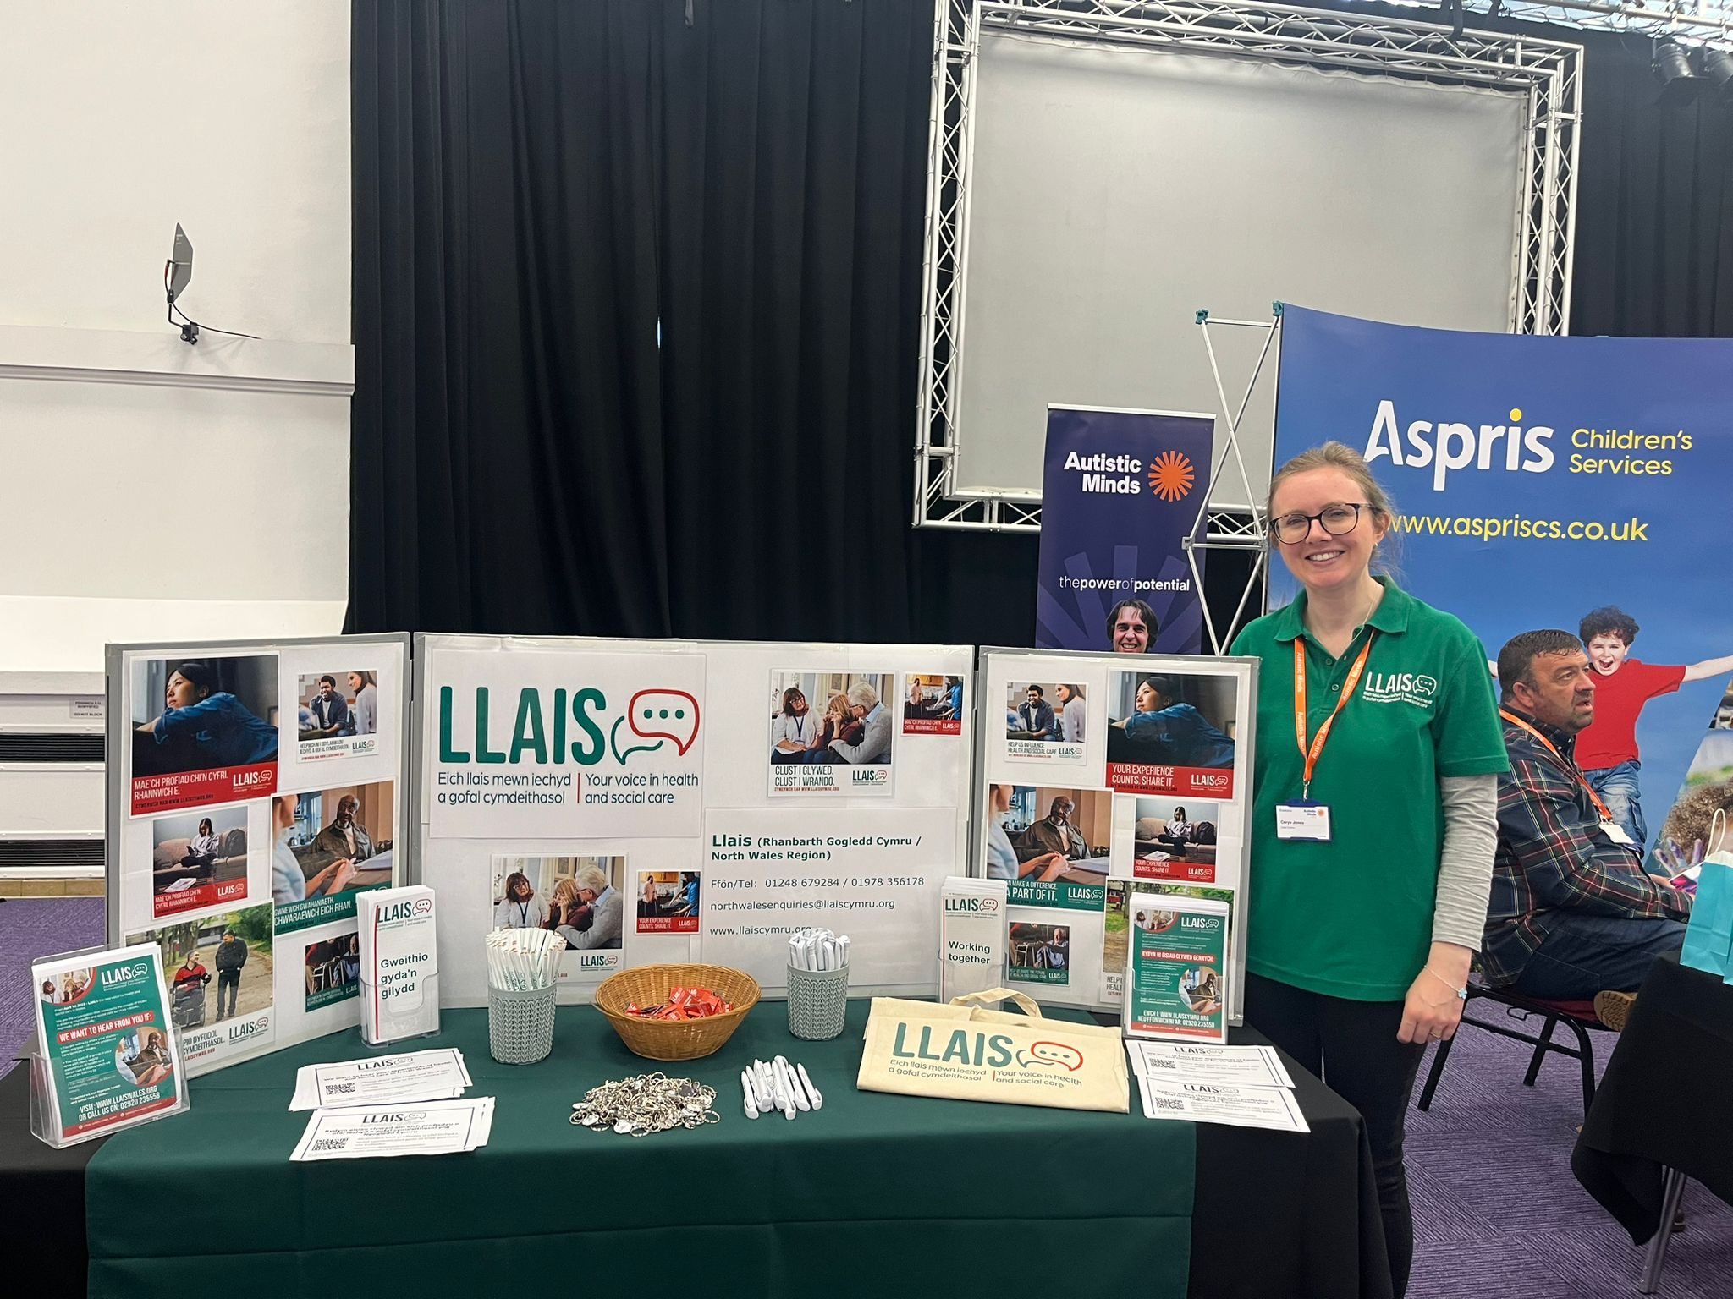
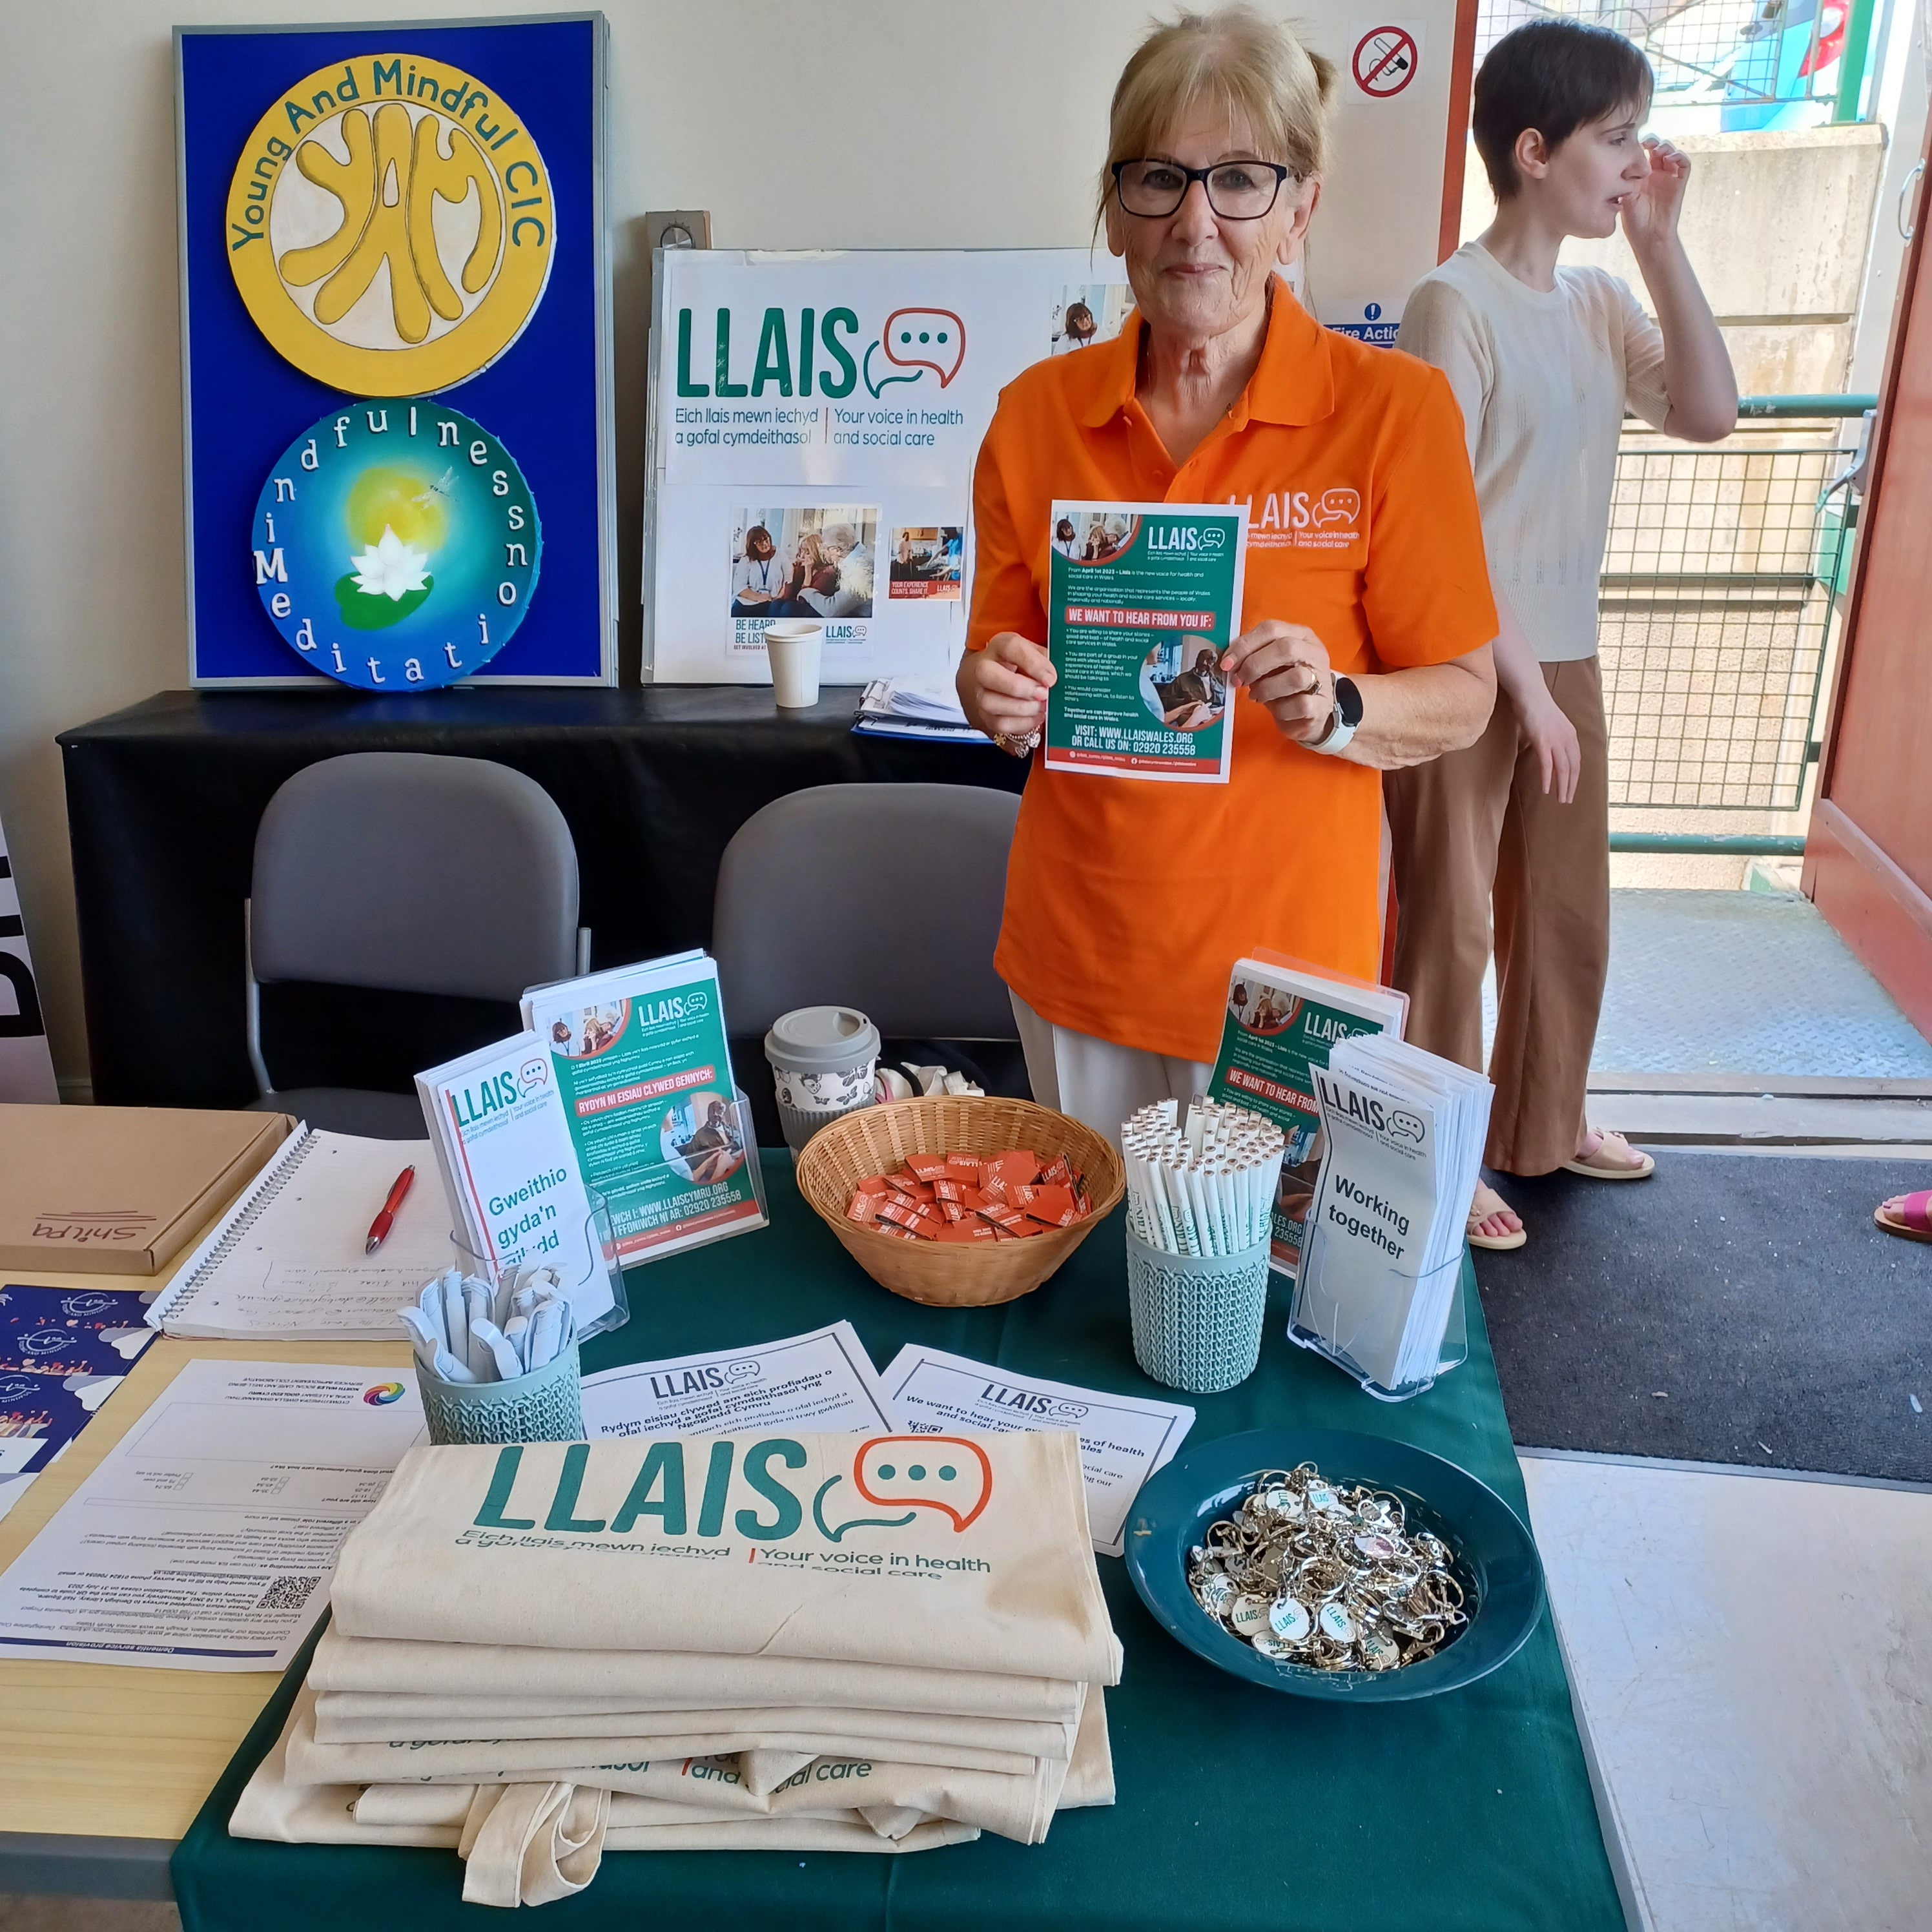
Ymgysylltu
Mae Gogledd Cymru wedi cael rhaglen ymgysylltu weithgar iawn, mae hyn yn cynnwys presenoldeb mewn digwyddiadau fel Balchder Sir y Fflint, Eisteddfodau Cenedlaethol a Rhyngwladol yn ogystal â'n digwyddiadau Mannau Diogel pwnc-benodol, gan gynnwys;
Therapi Iaith a Lleferydd
Menopos
Amseroedd Aros
Gwasanaethau Fasgwlaidd

